Slide 1
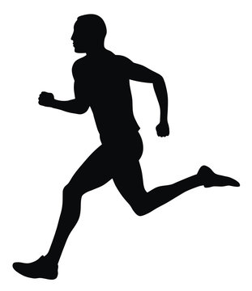
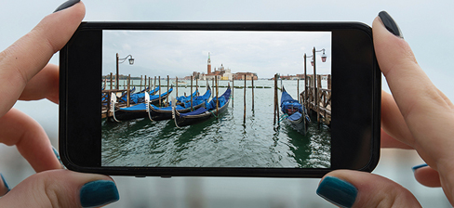
Name of our tool: AIMS (Artificial Intelligence Mapping for Sports)
Slogan: Train Informed
Put a “i” icon next to “Submit Video” to briefly explain what kind of video is more effective.
Or “at least a 60”
No sure about the distance
To get the most accurate kinematic analysis, use a 60-frame/sec camera in 6-20 ft distance and perpendicular to the runner to capture the full body movement.
~ 20 ft
This image needs improvement. It’s just showing the concept.
~ 6 ft

Slide 2
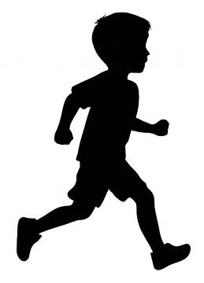
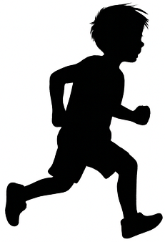
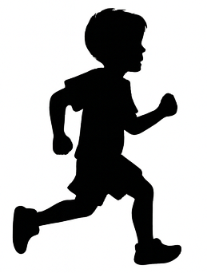
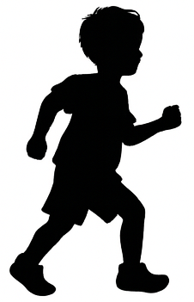
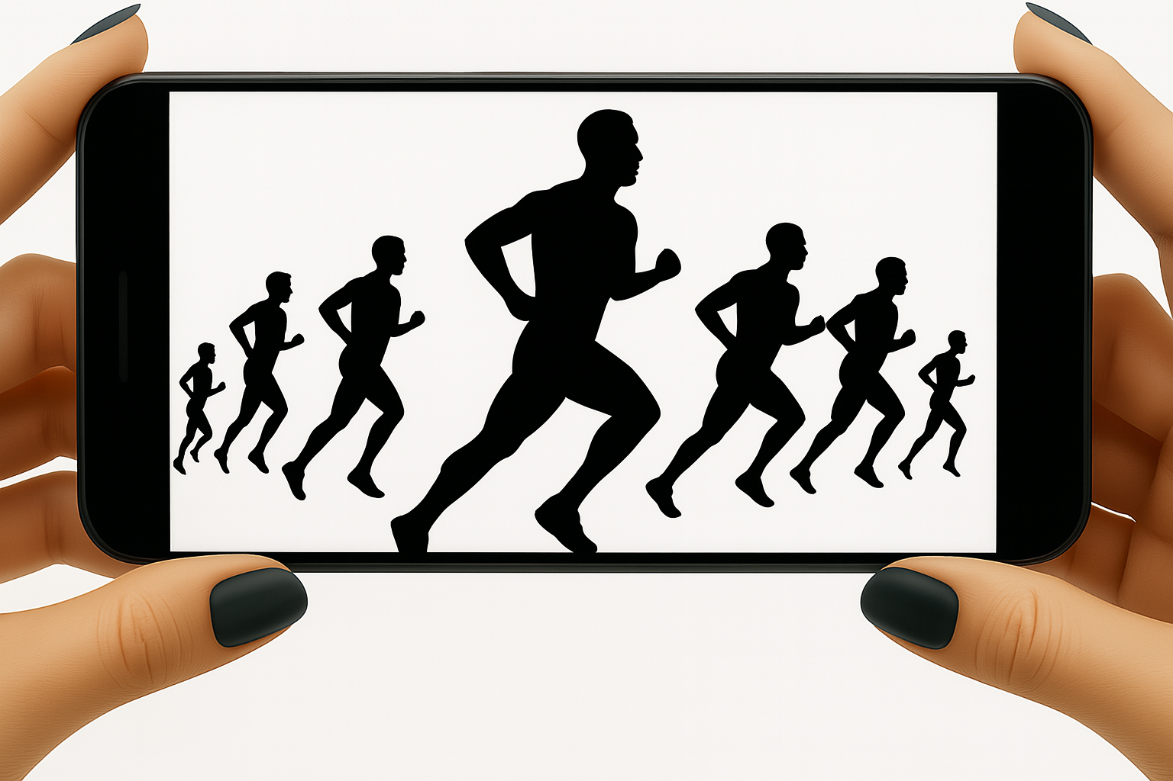
~ 20 ft
~ 6 ft

